Slide 1





ORGANIZED BY MALAYSIAN R USER GROUP (MYRUG)

Slide 2

Crafting Map in Communicable Disease Using tmap R Package
Dr Mohamad Afiq Amsyar
Department of Community Medicine
Universiti Sains Malaysia

Slide 3


MBBS (Manipal University) MPH (USM)
Candidate of DrPH at USM
Experiences:
Spatial analysis using various software including R for communicable diseases prevention and research project
Malaysia Disease Modelling Expert Group
Base in USM (Health Campus)
Consist of expertise from various area in medical sciences that are interested in conducting research related to disease modelling.

Slide 4
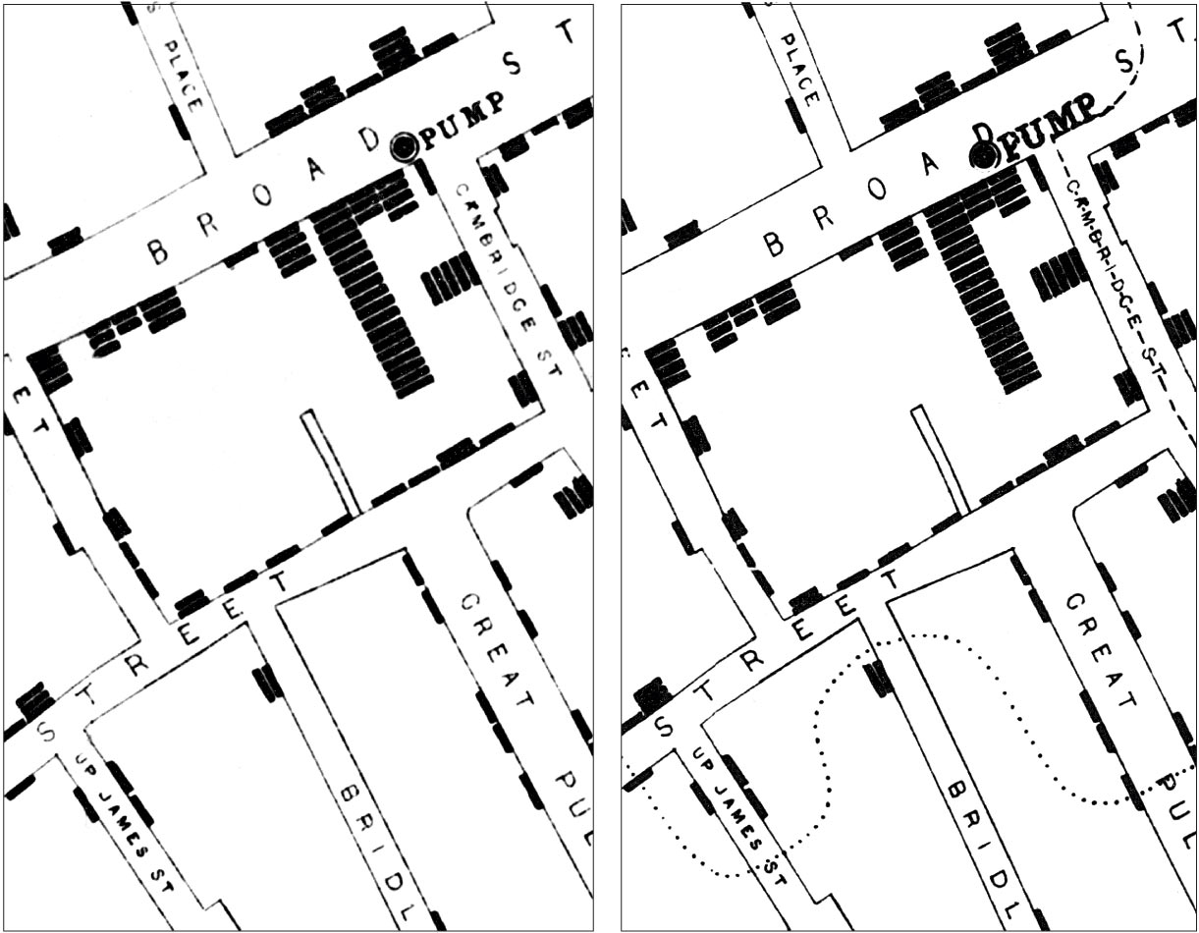
Outline
Introduction to spatial epidemiology
Data Visualization
Sf and tmap package
Demo (offline demo)
Conclusion
Summary
Source : John Snow Archive and Research Companion

Slide 5
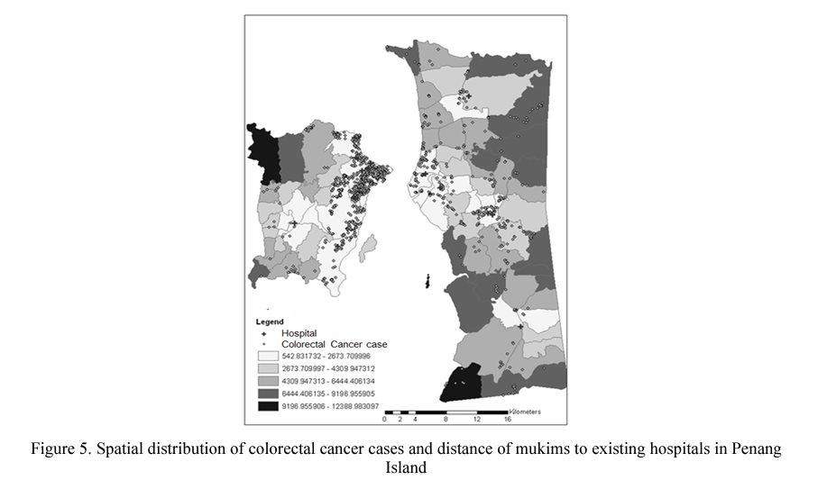
Spatial Analysis in Public Health
Samat, Narimah, et al. "investigating geographic distribution of colorectal cancer cases: an example from Penang State, Malaysia." Asian Social Science 9.17 (2013): p38.

Slide 6
Spatial Epidemiology
Spatial epidemiology is the description and analysis of geographic variations in disease with respect to demographic, environmental, behavioral, socioeconomic, genetic, and infectious risk factors.
Geographic analyses dating back to the 1800s when maps of disease rates in different countries began to emerge to characterize the spread and possible causes of outbreaks of infectious diseases such as yellow fever and cholera
Data set can be georeferenced by adding 2 columns that give x-coordinates and y-coordinates.

Slide 7
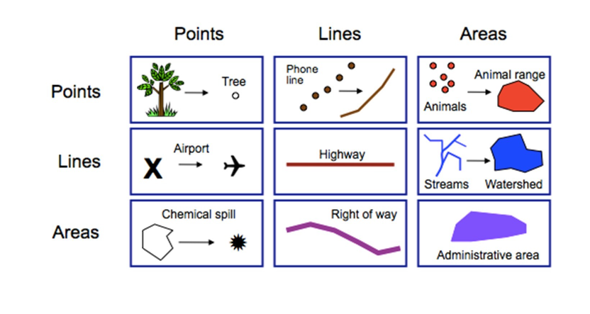
Spatial Data
Typical entities in GIS:
Points
Lines
Polygons / area
Volume

Slide 8
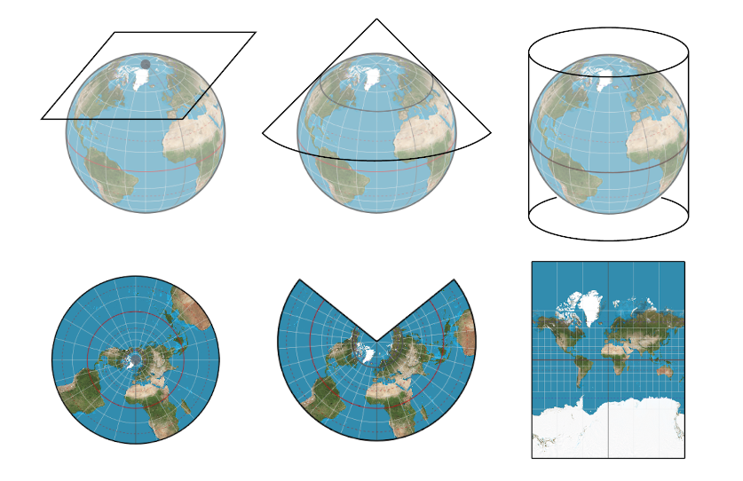
Map Projections
https://gistbok.ucgis.org/bok-topics/map-projections

Slide 9
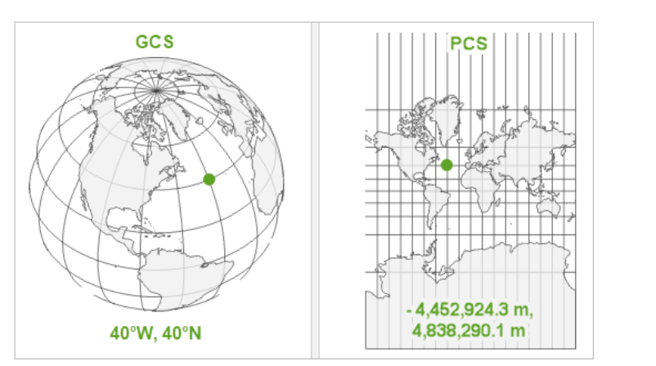
Coordinate Reference System (CRS)
Coordinate System:
Geographical
Projections
Source : ESRI

Slide 10
CRS in R
We need to know if the data is projected
which projection system is used
if not, you need to project it
use the correct system
most common projection is WGS84
good for mapping global data
When data with different CRS are combined
need to transform them to a common CRS so they align with one another

Slide 11
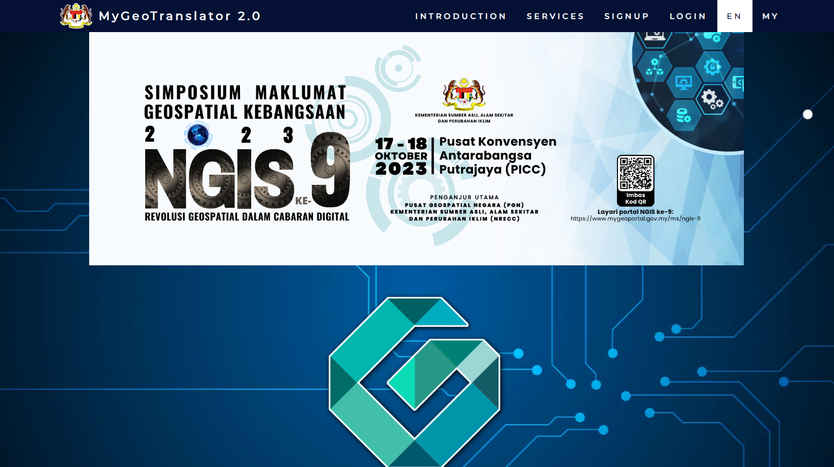
https://mygeotranslator.mygeoportal.gov.my/geotranslator/

Slide 12
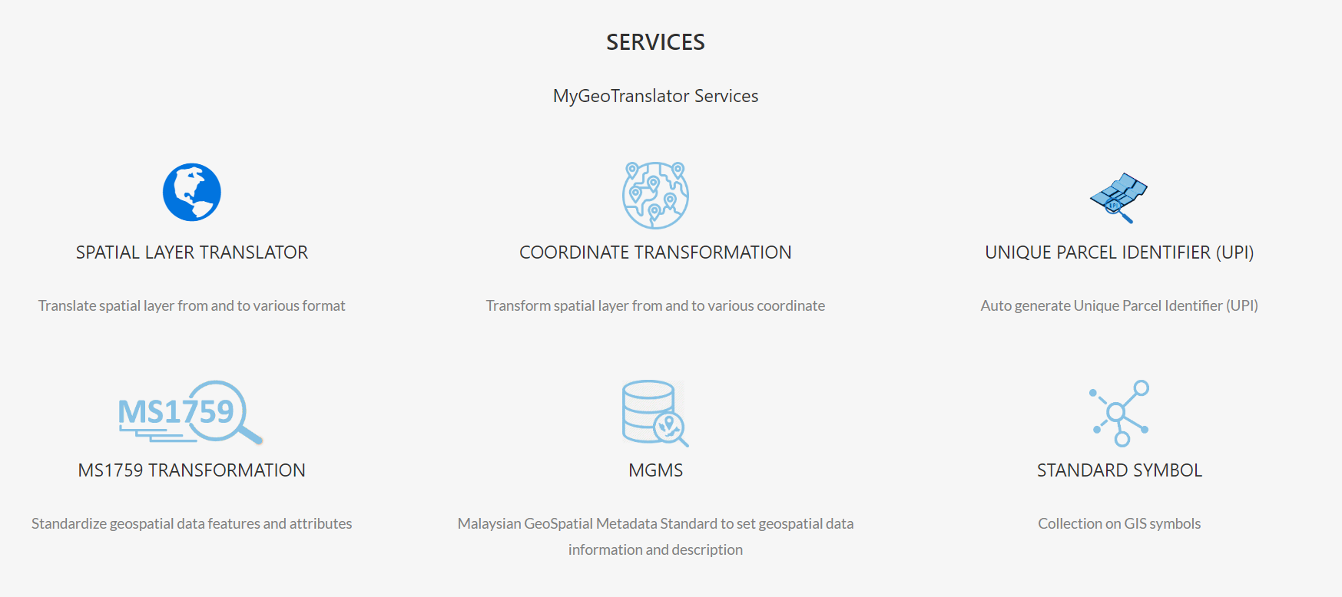
https://mygeotranslator.mygeoportal.gov.my/geotranslator/

Slide 13

Why R ??
Are not there any existing software??
QGIS, ArcGIS, SAGA
Close-source and focus primarily on spatial data, spatial analysis and maps
Dynamics of health data (involve more than just spatial variables)
Repeatability and reproducibility
Automation
If spatial analysis not the center of analysis

Slide 14
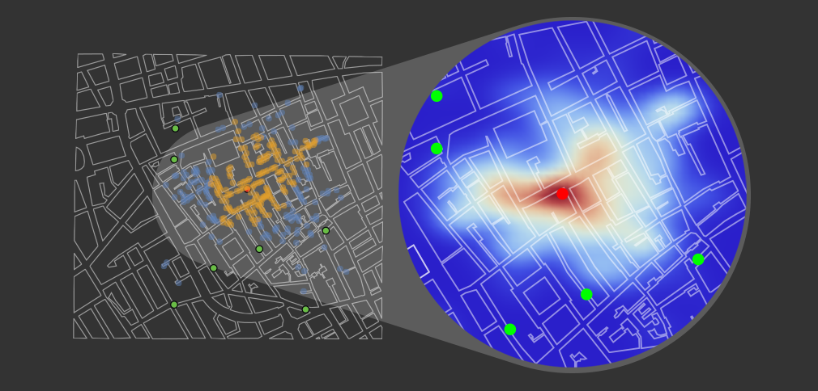

Spatial Epidemiology Inquiry
Disease Mapping
Disease pattern
Clustering
Assess potential exposure

Slide 15
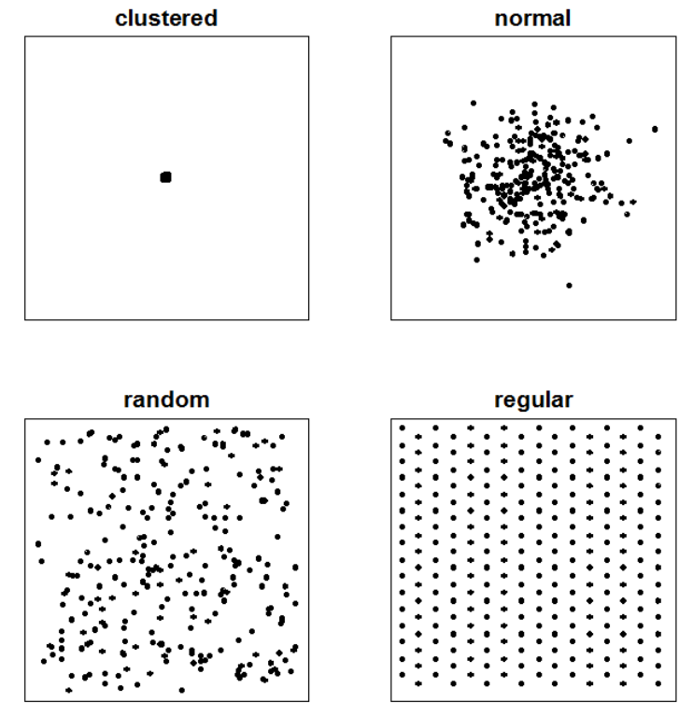
Data Visualization
Point Pattern Analysis
location of the points
Degree of aggregation
Random? Clustered? Regular?

Slide 16
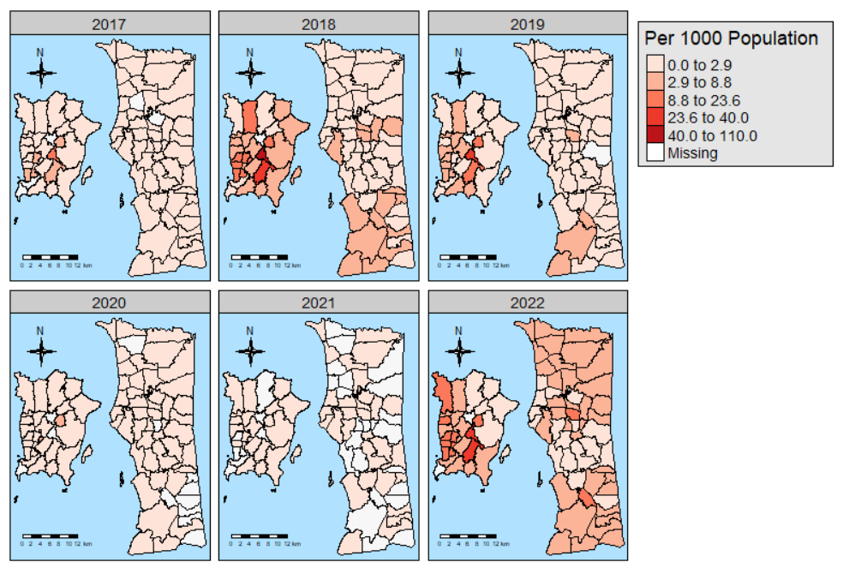
Data Visualization
Aggregated/ area data
Represent disease/ events over an area/polygon
Choropleth map
(one of the commonly used map to represent area data)

Slide 17
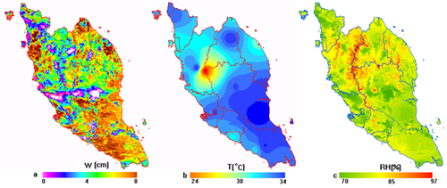
Data Visualization
Continuous spatial data
Eg: rainfall, temperature, windspeed

Slide 18
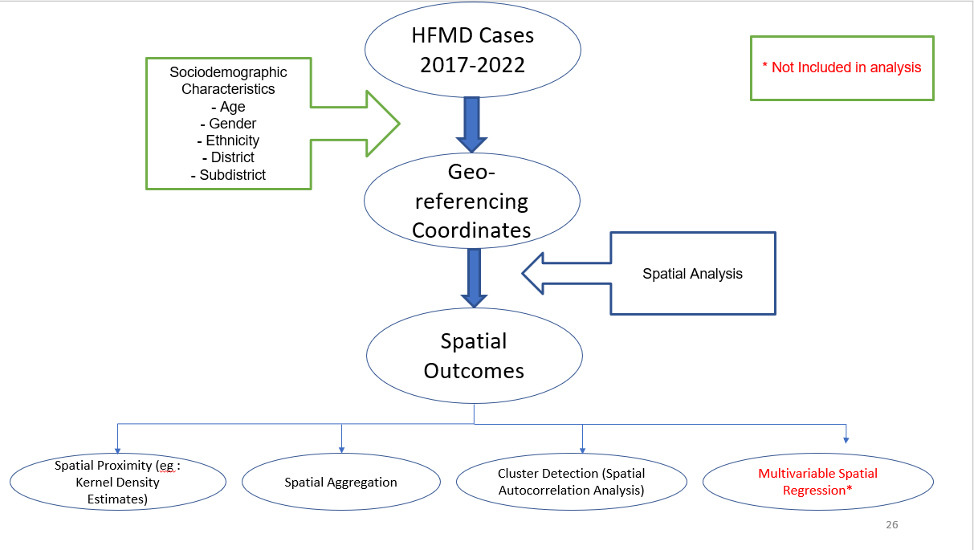
Workflow in Spatial Epidemiology

Slide 19

Spatial Analysis in Prevention and Control of Communicable Diseases
sf Package
Simple features are implemented using simple data structures
All functions and methods in sf that operate on spatial data are prefixed by st_.
Typical use involves reading, manipulating and writing of sets of features, with attributes and geometries.

Slide 20
Is treated as a data.frame
Can be used with a pipe operator
Can be linked directly to the GDAL, GEOS, and PROJ libraries that provide the back end for reading spatial data, making geographic calculations, and handling coordinate reference systems.

Slide 21
Important Functions
st_as_sf (Convert foreign object to an sf object)
st_is_valid (Checks whether a geometry is valid, or makes an invalid geometry valid)
st_crs (Retrieve coordinate reference system from sf object)
st_transform (Transform or convert coordinates of simple feature)
st_distance (Compute Euclidian or great circle distance between pairs of geometries; compute, the area or the length of a set of geometries)
st_intersects (To find whether pairs of simple feature geometries intersect)
st_join (joint data from multiple layer)

Slide 22
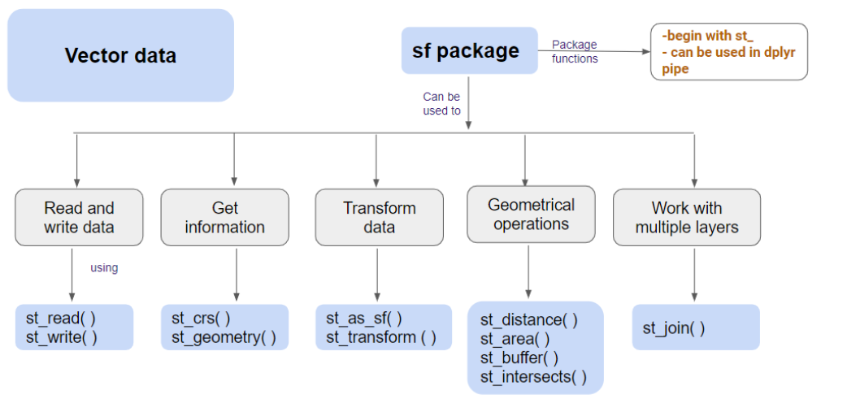

Slide 23
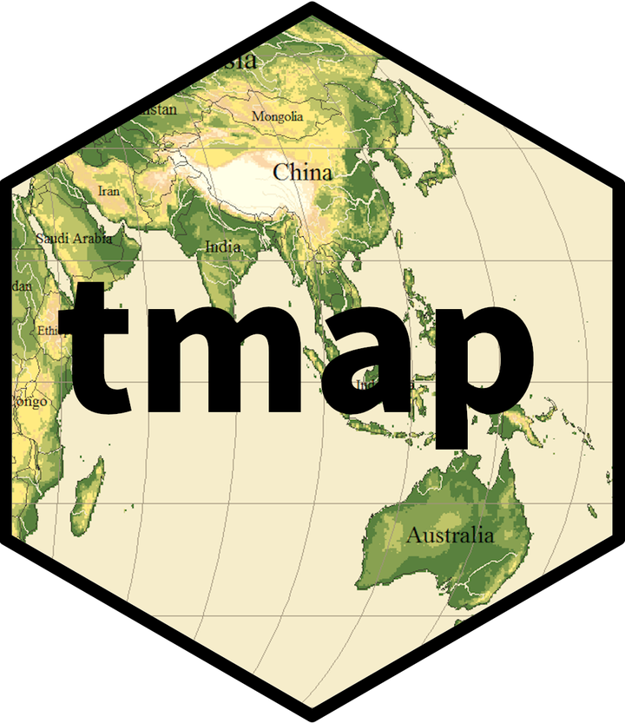
tmap Package
tmap offers a flexible, easy to use, and layer-based approach to crafting thematic maps (Martijn Tennekes 2008a)
Provide R users with flexible way to make thematic maps, requiring a minimum amount of code
The tmap package stands on the shoulders of the following R packages.
sf (Pebesma and Bivand 2005)
raster (Hijmans 2017)
rgdal (Bivand, Keitt, and Rowlingson 2017)
rgeos (Bivand and Rundel 2017
RColorBrewer (Neuwirth 2014): (R Core Team 2017)
leaflet (Cheng, Karambelkar, and Xie 2017)
Tennekes, M., 2018, tmap: Thematic Maps in R, Journal of Statistical Software, 84(6), 1-39,
Notes:
SF : This package contains classes and methods for spatial data Raster : This package contain classes and methods for rastered spatial data Rgdal : Reading and writing ESRI shape files is done with this package, as well as map projections via the PROJ.4 library Rgeos : All geometric processing is carried out by this package RColorBrewer : All used color schemes have been proposed by Brewer, Hatchard, and Harrower (2003) and have been implemented in this package. grid
Leaflet : This package is an R interface to the JavaScript library Leaflet (Agafonkin 2017) for interactive maps.

Slide 24
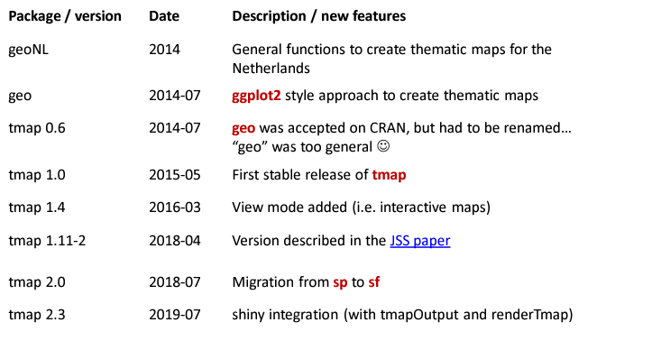
History

Slide 25
Plotting and Interactive Viewing
The tmap package contains two drawing modes: plot and view
The output of the "plot" mode can be saved with the function save_tmap to static formats, such as JPG, PNG, SVG, and PDF
In the interactive viewing mode, Within RStudio, these are shown in its viewer pane, and otherwise, in a web browser. Users are able to zoom, pan, and click on the spatial units.

Slide 26
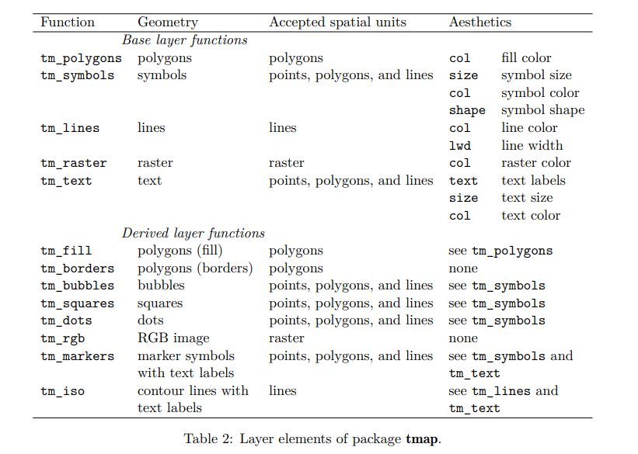
Aesthetics in tmap Package
Notes:
vector of constant values or data variable names can be assigned to one of the aesthetics

Slide 27
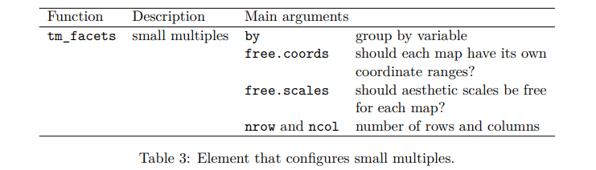
Faceting the Map into Variables

Slide 28
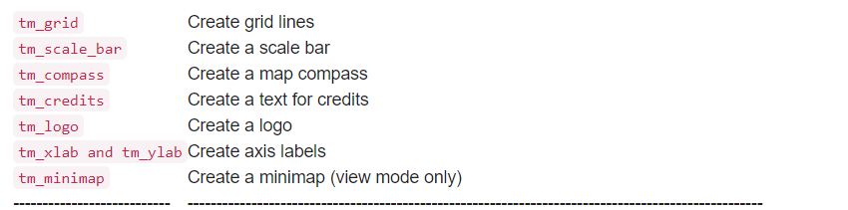
Attributes
Tennekes, M., 2018, tmap: Thematic Maps in R, Journal of Statistical Software, 84(6), 1-39,

Slide 29
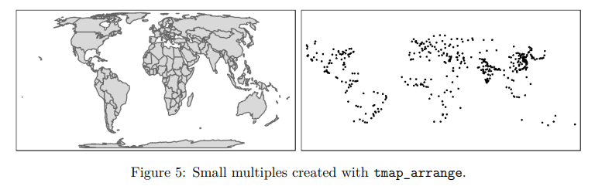
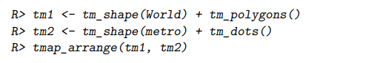
Grid Layout
Using tmap_arrange function
Eg :
Tennekes, M., 2018, tmap: Thematic Maps in R, Journal of Statistical Software, 84(6), 1-39,
Notes:
The third and final method to create small multiples is by creating several independent maps and use the function tmap_arrange to arrange them in a grid layout

Slide 30

Demonstration
https://github.com/afiqamsyar90/Rconf_DiseaseMapping

Slide 31
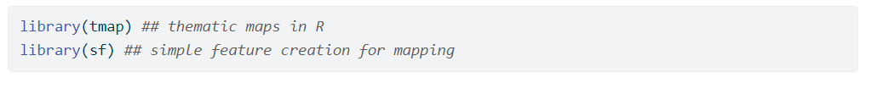
Load Packages
Read Data

Slide 32
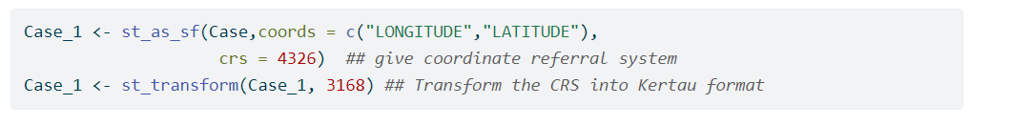
Data Conversion to sf objects

Slide 33
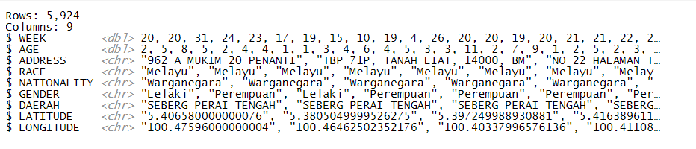
sf Objects

Slide 34
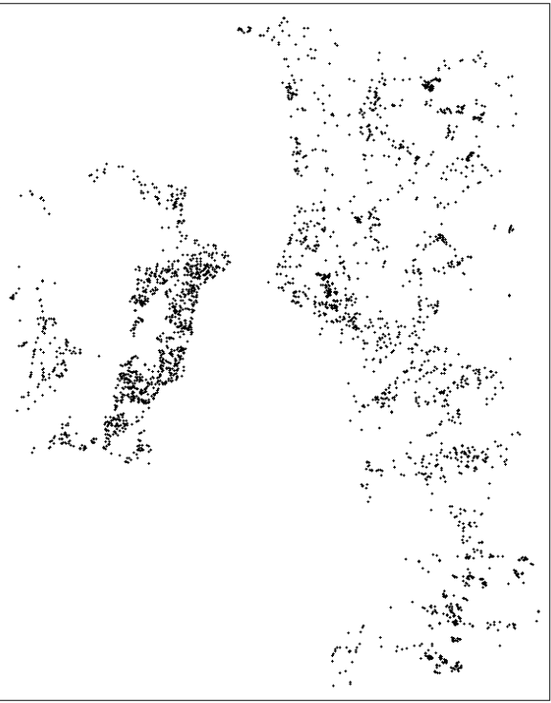
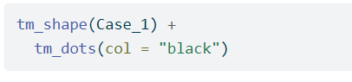
Plot the case

Slide 35

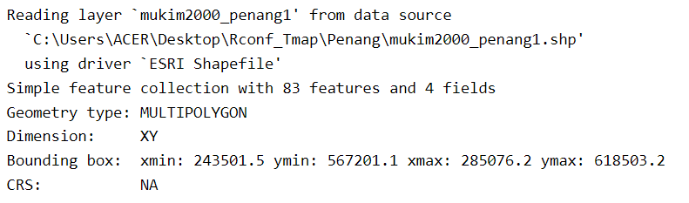
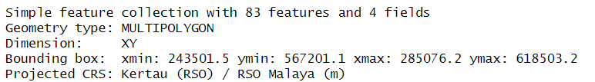
Load the base map
Set CRS for base map

Slide 36
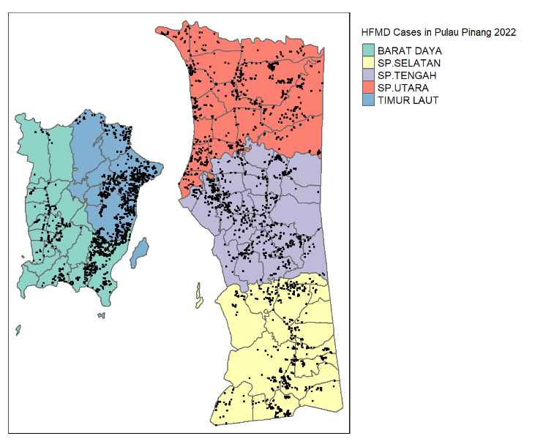
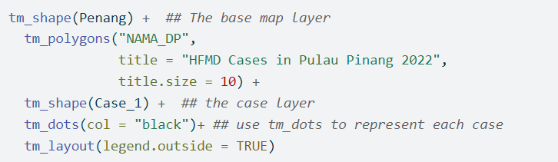
Visualize on the base map

Slide 37
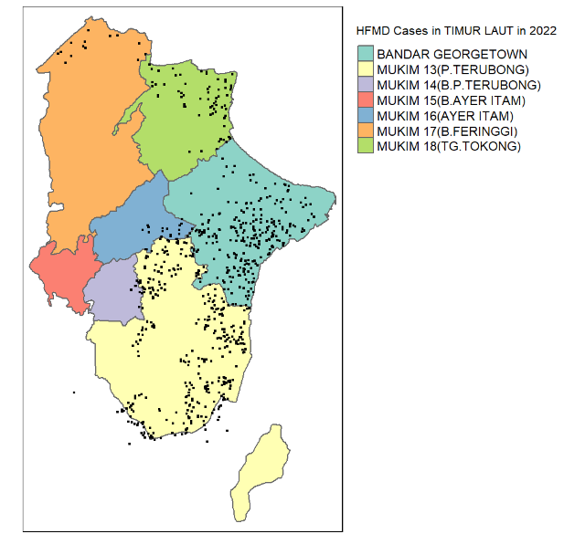
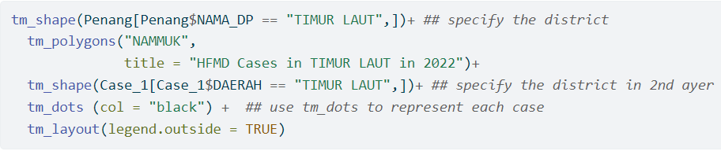
Specify the location

Slide 38
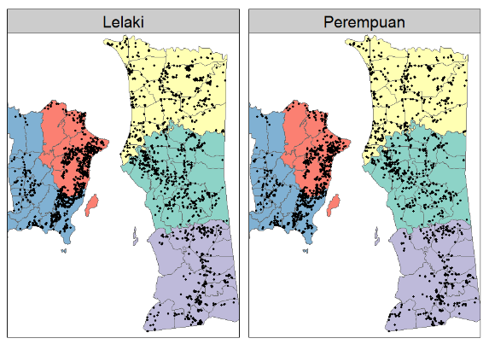
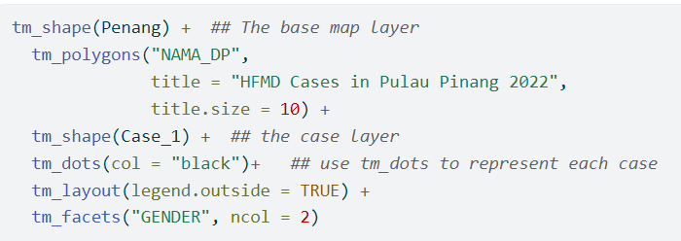
Visualize Categorical Data

Slide 39
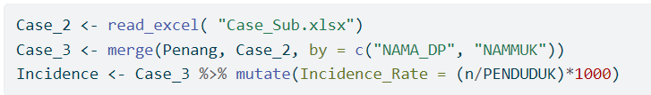
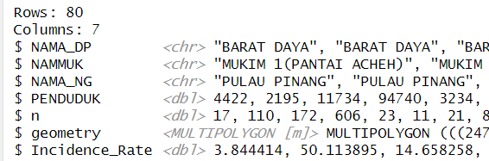
tmap for Thematic Map
Load Data

Slide 40
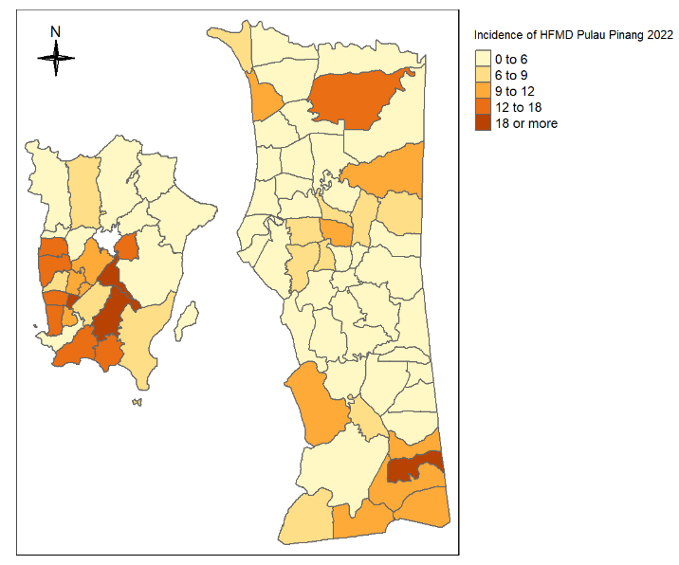
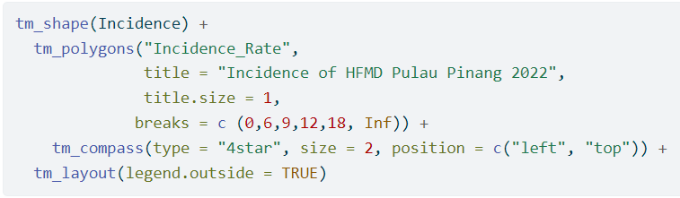
tmap for Thematic Map
Plot incidence
Cosmetics

Slide 41
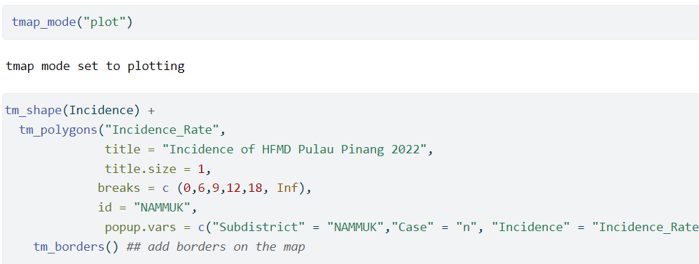
tmap for Thematic Map

Slide 42
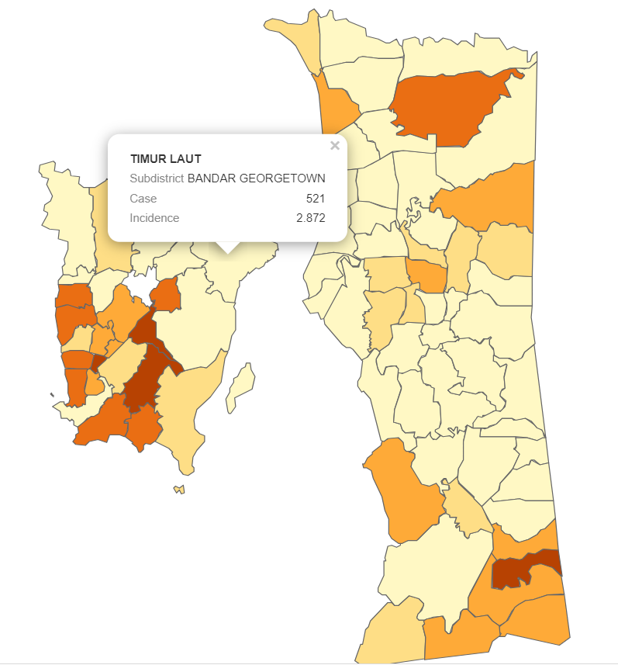
Interactive Thematic Map

Slide 43
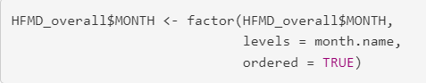
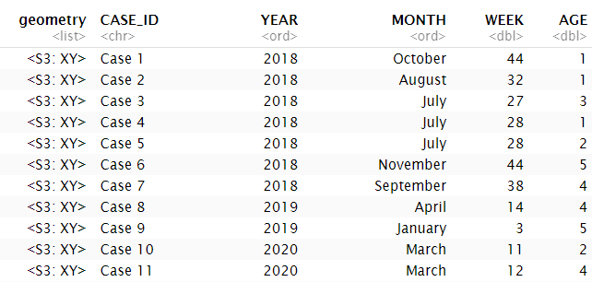
tmap for serial events
Convert variable to factor with ordered level

Slide 44
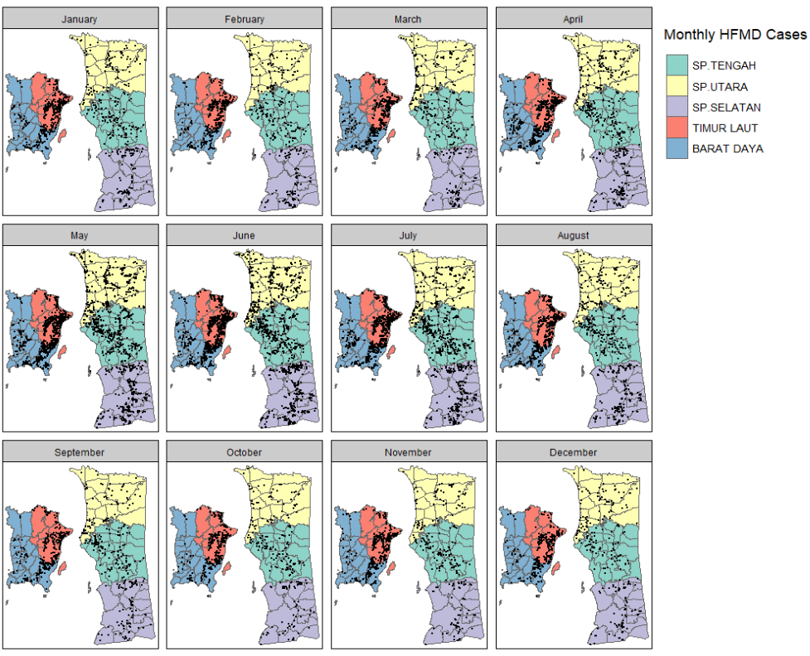
Small multiple maps

Slide 45
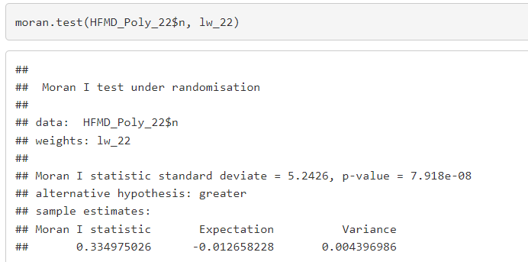
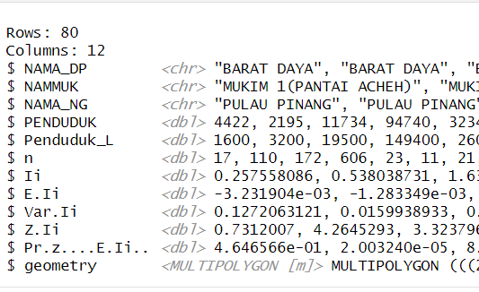
Compute Spatial Autocorrelation
tmap for map with statistical properties

Slide 46
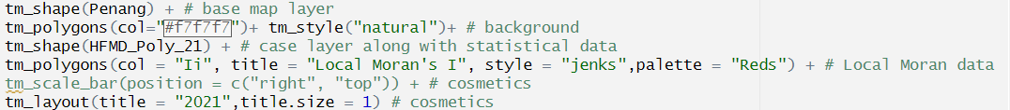
tmap for map with statistical properties
tmap enable integration of statistical properties following spatial analysis.

Slide 47
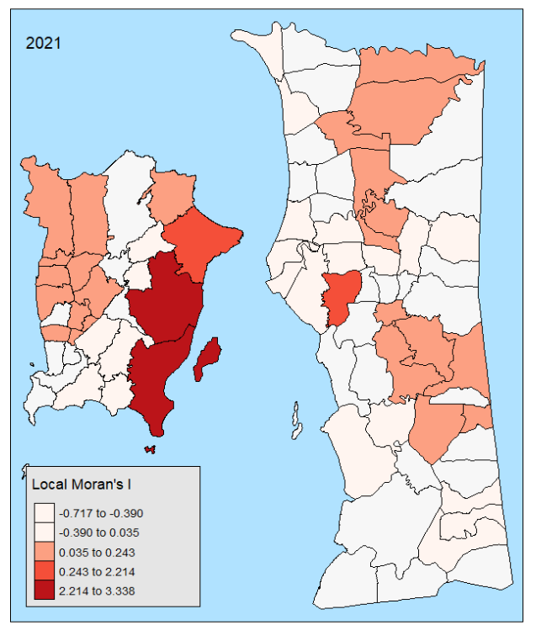
tmap for map with statistical properties

Slide 48
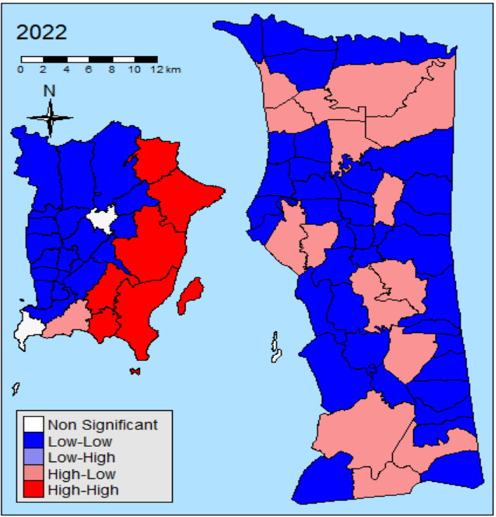
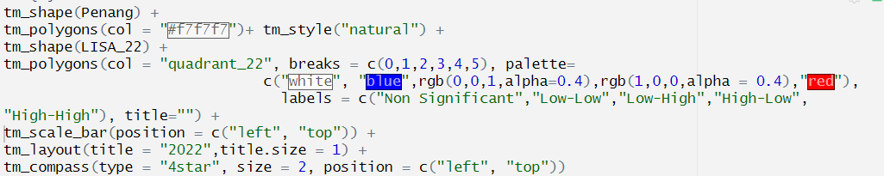
tmap for map with statistical properties

Slide 49
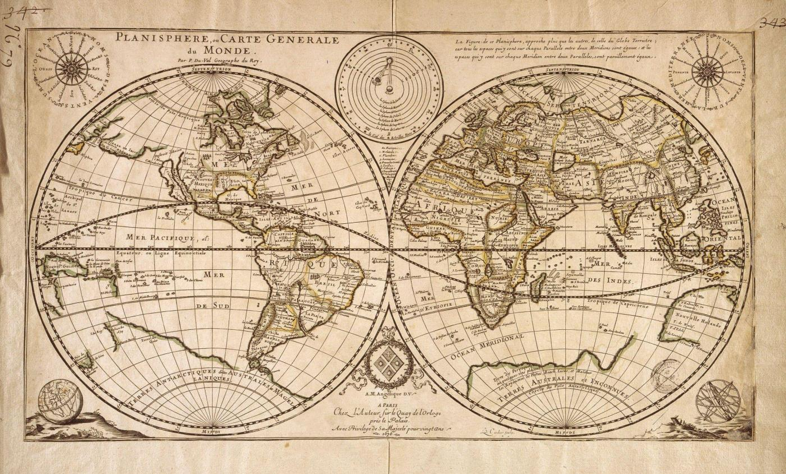
Limitation of Spatial Data in Communicable Diseases
Inaccurate data
Confidentiality
Use of ZIP codes
Geocoding issues
Uncertain location

Slide 50
Conclusion
Maps serve as tool to communicate data to relevant authorities and direct comparison in public health analysis and reports.
tmap package assist public health researcher in producing informative and summarize disease distribution in minimal amount of time
Issues of incomplete data, confidentiality, geocoding issues and uncertain location of event/disease might affect the accuracy of spatial analysis

Slide 51
Summary
Tmap is a powerful package for spatial data visualization
It is based on the syntax of ggplot2, but tailored for maps
Other awesome mapping packages are ggplot2, leaflet, mapview
The key qualities of tmap are:
Intuitive and easy to understand syntax (therefore very suitable for educational purposes)
Many options to configure the map
Two modes: static and interactive maps

Slide 52
References
Tennekes, M. (2018). tmap: Thematic Maps in R. Journal of Statistical Software, 84(6), 1–39. https://doi.org/10.18637/jss.v084.i06
Paula Moraga (2021) Handbook of Spatial Epidemiology, Journal of the American Statistical Association, 116:533, 451-453, DOI: 10.1080/01621459.2021.1880230
https://cran.r-project.org/web/packages/tmap/index.html

Slide 53

Thank You
Personal Email : amsyarafiq90@gmail.com
Student Email: afiqamsyar90@student.usm.my

